Slide 1
Going to the seaside from mime to movie

Slide 2
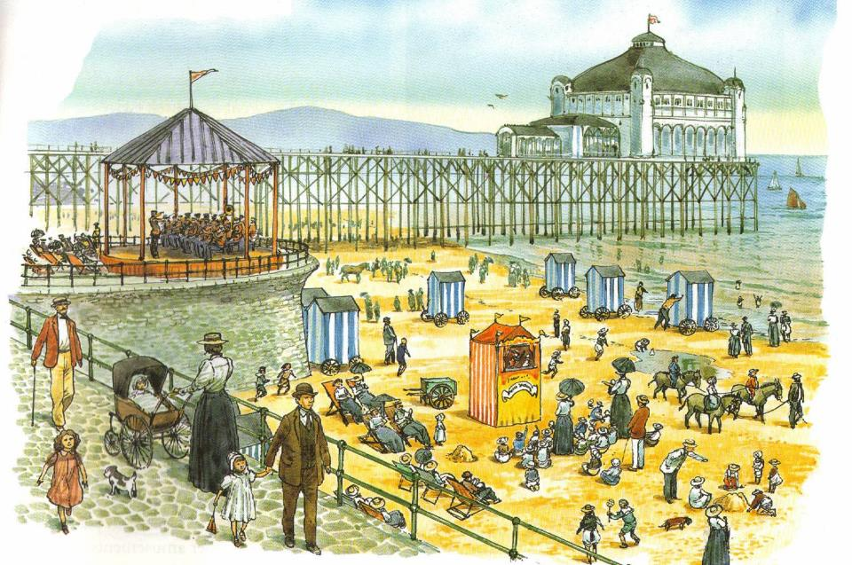

Slide 3
Credits
We are grateful to Heinemann Education for permission to reproduce the image

