Slide 1
Going to the Seaside
Y1/2 assessed work
Seaside 100 years ago Assessment – Life in the past

Slide 2
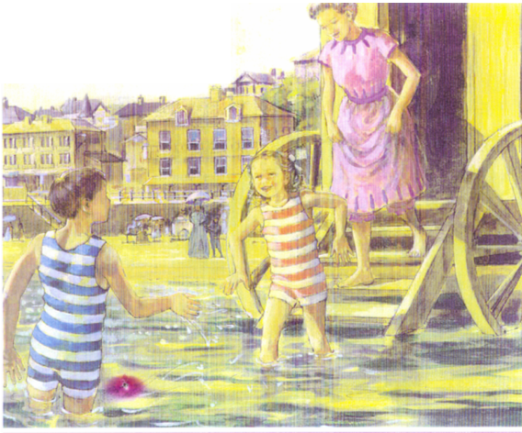
1. What does this picture tell
us about seaside holidays
100 years ago?
2. What else happened at the seaside 100 years ago that is not in the picture?

Slide 3
For Mark scheme and sample answers with analysis see the resource in Assessment Key Stage and Judging pupil’s work (Members Only)
 | Characteristic features of answers | Typical pupil responses
Well below average WBA
Below average BA
Average A
Above average AA

Slide 4
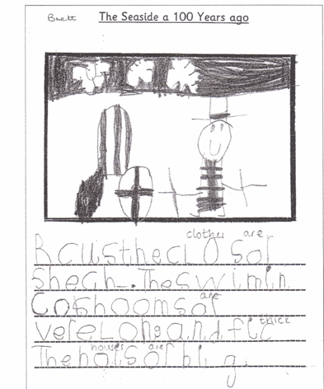
Brett Y1
Brett in Y1 has identified one difference between the past and the present…

Slide 5
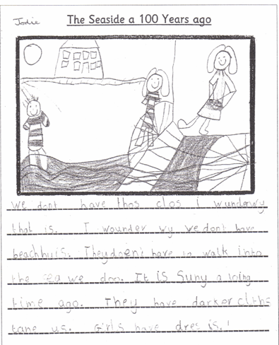
Jodie Y1
Jodie’s answer is just below average for Y1. Her reference to beach-huts…

Slide 6
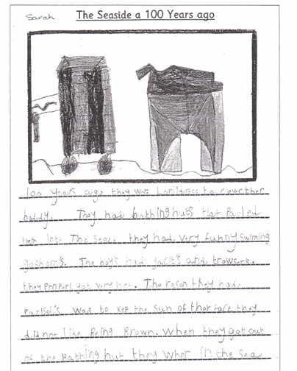
Sarah Y1
Sarah’s answer is above average. She confidently picks out the key differences…

Slide 7
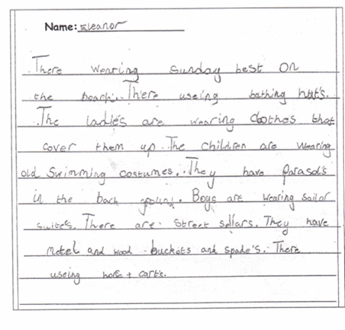
Eleanor Y2
Eleanor’s is a full answer. She pinpoints the key differences without any obvious omissions…

