Slide 1
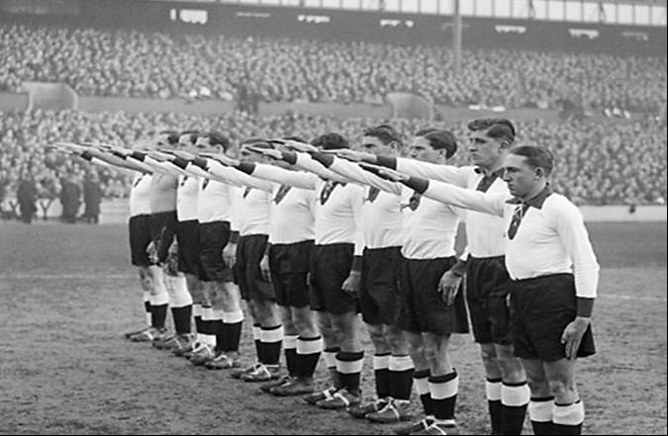
Looking at international relations 1919-39
Using football to clarify key themes

Slide 2
1920s isolation
Germany was diplomatically isolated in the early 1920s (she was not invited to attend the 1902 or 1924 Olympics and the FA did not arrange any football fixtures).

Slide 3
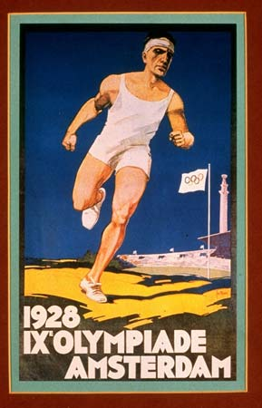
1928 Recognition
Germany’s coming in from the cold during the Streseman Years. (In 1928 she was invited to participate in the Olympics.)

Slide 4
First match England v Germany 1930
Germany was accepted by the Allies
The first full international between England and Germany since the war took place in1930. It was a draw, 3-3. You can see a minute of the match by clicking here for ITN film clip.

Slide 5
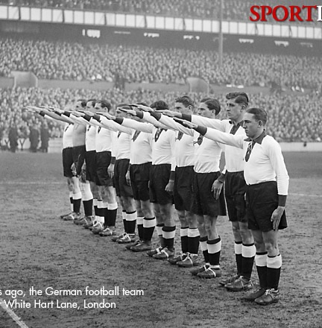
Re-match 1935
The return fixture, scheduled for 1935, was greeted with considerable opposition, not least by protests from Jewish organisations. Note the German players Nazi salutes. (England won 3-0). Proposed demonstrations never materialised. It helped that the British Government had asked the German authorities to forbid the wearing of Nazi symbols by the travelling supporters.

Slide 6
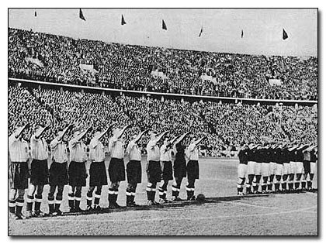
1938 tension mounts
The next match was fixed in November 1937 to take place in May 1938. The German team had become even stronger because the annexation of Austria in the Anschluss of March 15, 1938, just two months before the meeting with England, gave them the pick of the many fine players who had performed for Austria, perhaps Europe's strongest national side during the early 1930s.

Slide 7
1938 tense times
At the May 1938 match English players had to give the Nazi salute to Goebbels, Goering, Hess and Ribbentrop (Hitler was not present). The British were frightened of antagonising the Nazi regime. The German team contained former Austrian players, following Anschluss. (England won 6-3!)

Slide 8
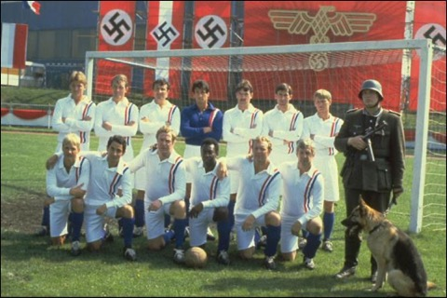
The match that never happened!
The return match was scheduled for 1939-40 and never happened, nor did the fictional one in Escape to Victory!! (shown here).
The next match was actually in 1954 and England won again 3-1. (Stanley Matthews played in this match as he had done so brilliantly in 1938!)

