Slide 1
Free at last?
How far had Civil Rights come in the 20 years after the Second World War?
Part of a 3 or 4 lesson enquiry

Slide 3
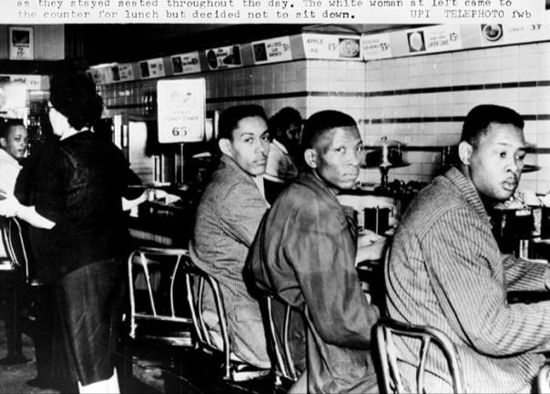
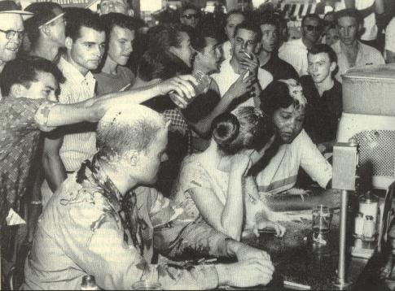
A

Slide 4
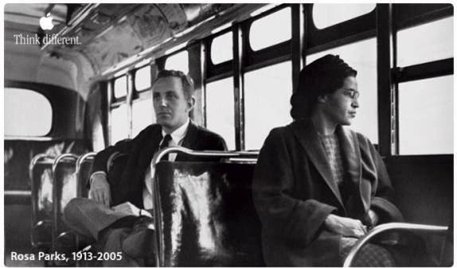
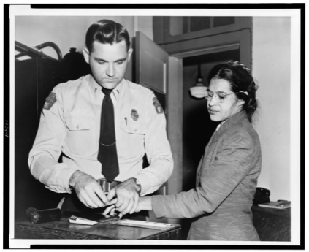
B

Slide 5
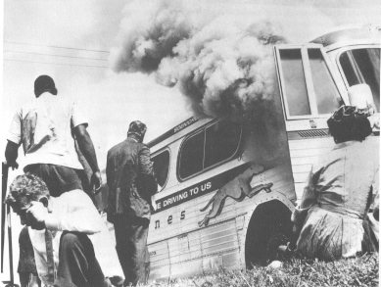
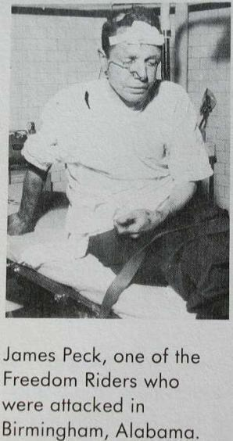
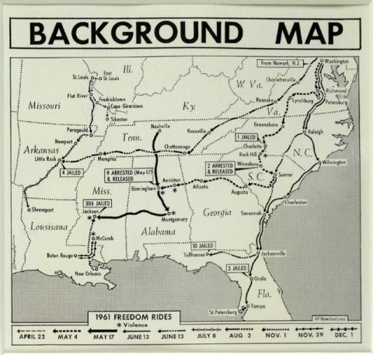
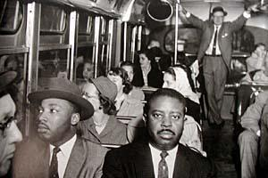
C
5

Slide 6
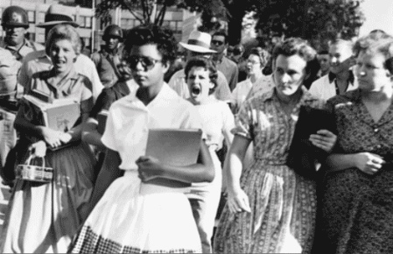
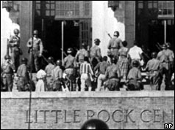
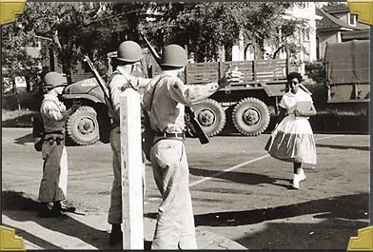
D

Slide 7
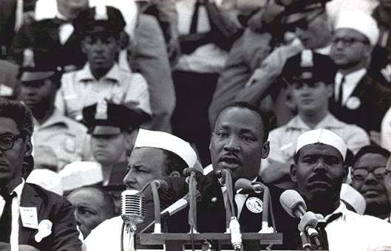
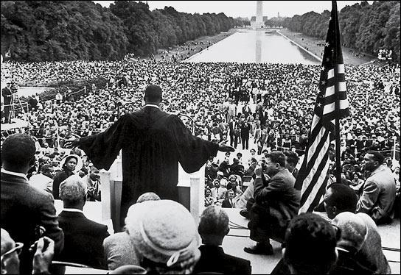
E

Slide 8
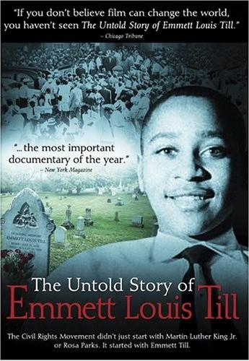
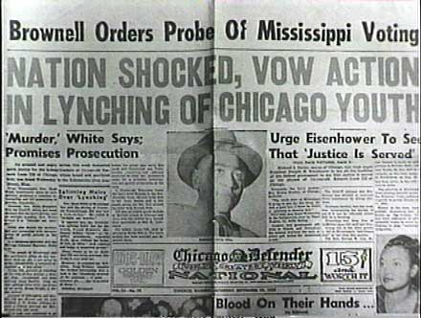
F

Slide 9
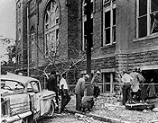
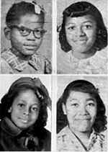
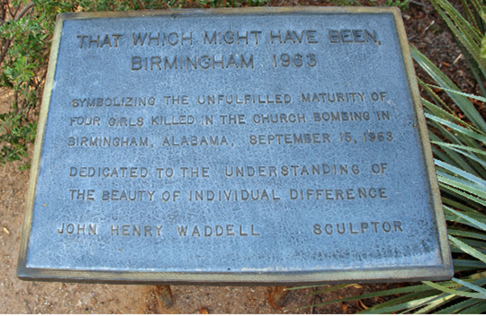
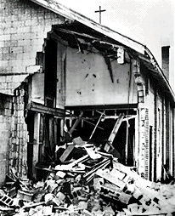
G

Slide 10
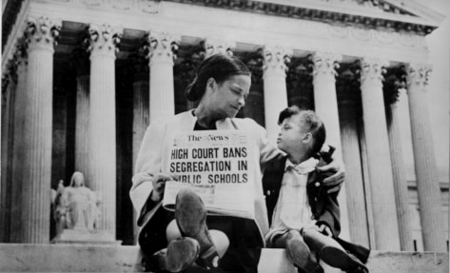
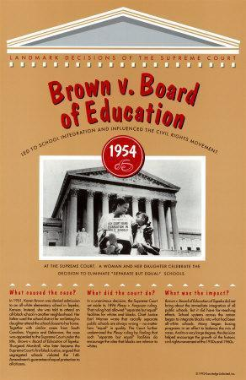
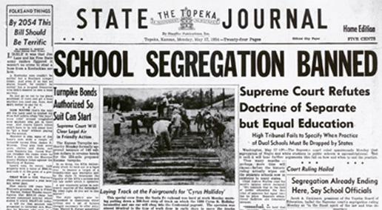
H
10

Slide 11
Rosa Parks and the bus boycott ......... | Horrific murder of Emmett Till........ | Bombing of church in Birmingham Alabama, kills 4 black children... | Little Rock, armed escort needed for black students......
March on Washington and Martin Luther King’s speech ....... | Freedom riders challenge segregation of buses ........ | Restaurant sit-ins ..... | Education desegregated in legal case of Brown v Topeka......

Slide 14
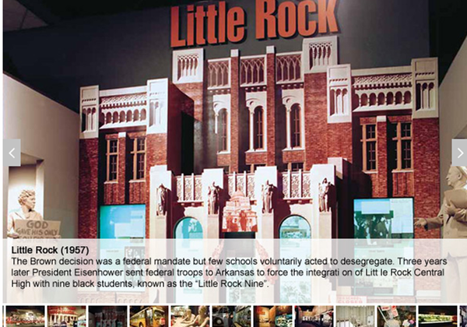

Slide 15
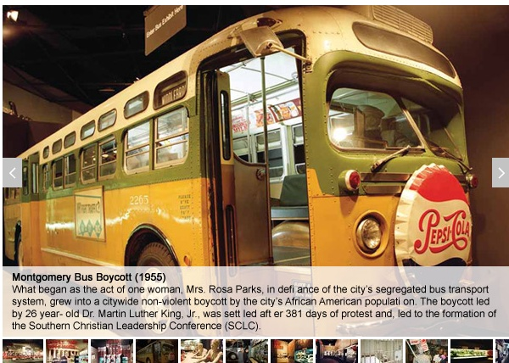

Slide 16
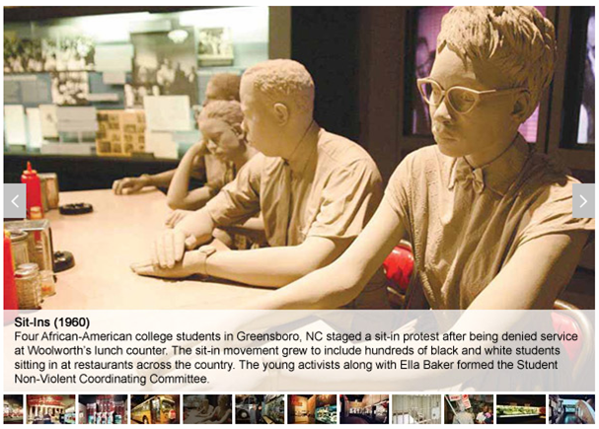

Slide 17
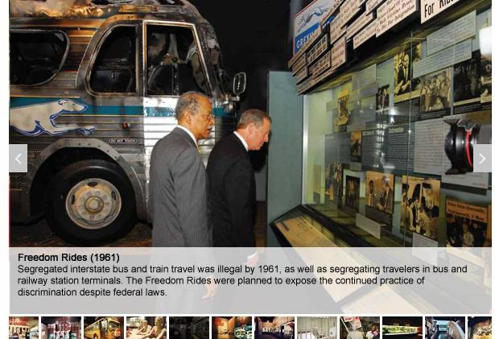

Slide 19
Our own class living graph
Equality
Draw a living graph to show
Starting point
When fortunes improved and by how much
When things didn’t improve much
How far the struggle for equality has actually come
1950 1955 1960 1963

Slide 20
Which were the most important turning points in the
Civil Rights Movement 1950-63?
Very significant
1950 1955 1960 1963

Slide 21
Looking for significance. Which are the key criteria?
Dealt with a major issue (right to vote, health, education, fair policing, segregation)
Brought about instant improvement
Led to a big change quite quickly
Encouraged others to takes steps they might not have done
High profile event; large crowd. Media coverage
Changed people’s thinking forever.

Slide 22
Examples please!
“The Montgomery bus boycott was clearly an event of major importance in the Civil Rights campaign. Yet it did not immediately produce dramatic protests and events.”
Extract from recent text book

Slide 24
Do all textbooks agree?
One KS3 book starts with the Montgomery bus boycott, nothing before 1955.
No reference to Emmett Till at all in a widely used GCSE textbook on the topic.
One KS3 book has a whole double-page spread on Emmett Till.
Some say that events had a negative effect, making whites even more determined to stop Civil Rights!

Slide 25
10 words and phrases that express significance
The spark that set alight
Started the ball rolling
A landmark case/event
Without this it wouldn’t have happened
Crucial
The key turning point
Tranformed the movement
The catalyst that led to other changes
Fundamental to the success
Pivotal

Slide 26
Credits
Civil Rights Museum

