Slide 1
COURT OF KING CHOLERA?
Where are you in this picture?
Cartoon reproduced with permission of Punch Ltd www.punch.co.uk

Slide 2
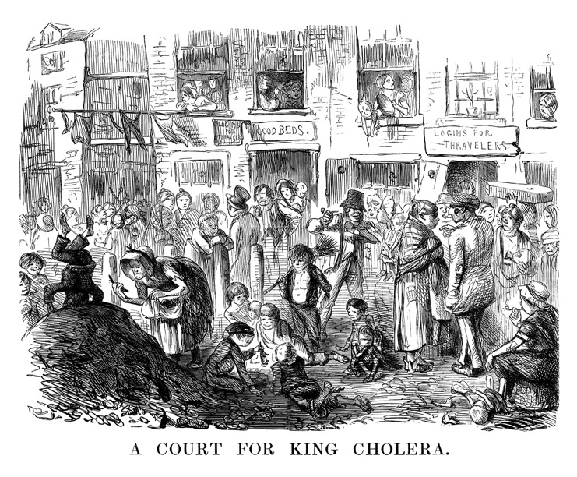

Slide 3
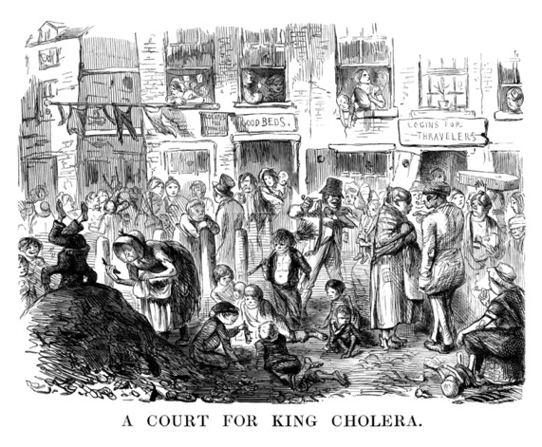

Slide 4
Did you notice? moving clockwise...
The poor spelling of ‘lodging house’
The coffin being carried
The infant lying in the filth
The bare-footed children
The boy holding a rat by its tail
The crazy kid doing a head stand in the dung heap
The props holding the ramshackle buildings up

Slide 5
Did you notice? moving clockwise...
The filthy overcrowded conditions in which so many people lived ensured the rapid spread of cholera. Contact with human excrement and flies which had themselves been in contact with human excrement was inevitable. The worst source however was contaminated water. Cholera attacked with terrible suddenness and victims could die within a few hours, or after a few days of violent pain and diarrhoea. Where transmission was by contact whole households died, but where it was waterborne whole streets and areas were affected. There was no effective treatment, and one in two of those infected died.

Slide 6
Why didn’t people do anything about it?
We prefer to take our chance with the cholera than be bullied into health. There is nothing a man hates so much as being cleansed against his will or having his floors swept, his hall whitewashed, his dungheaps cleared away and his thatch forced to give way to slate. It is a fact that many people have died from good washing. The truth is that Mr Chadwick has a great many powers but it is not so easy to say what they can be applied to.
The Times, 1854

