Slide 1
WW2 – KQ2c
Just how happy were evacuees?
Can we help the BBC to improve its website on Eric the evacuee?

Slide 2
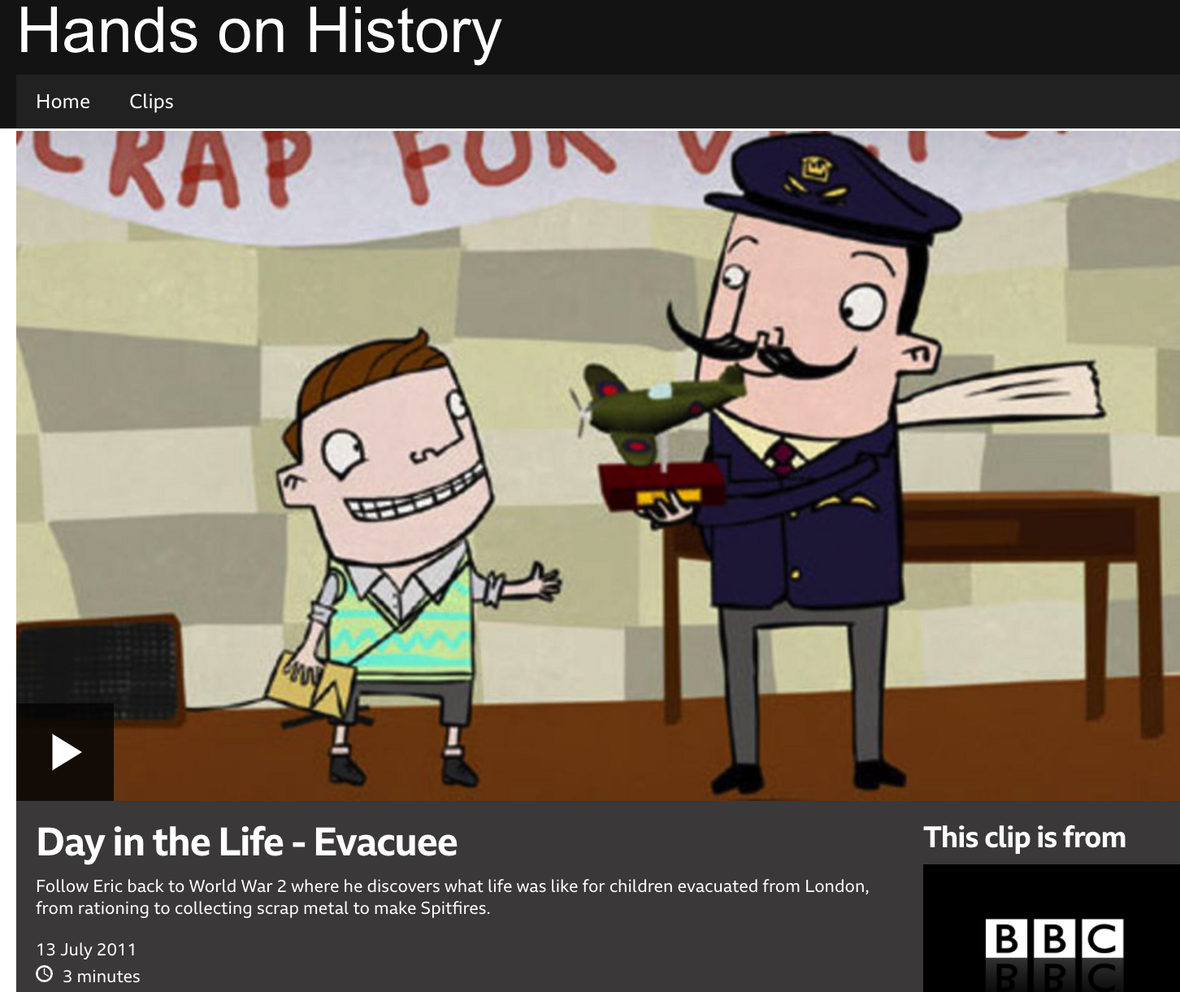
Help!
Can any primary school children help us to make this website animation a few minutes longer and even better?
https://www.bbc.co.uk/programmes/p00b3g7f

Slide 3
Were all evacuees as happy as Eric?
Let’s look at some of the evidence from the time: one photo and the memories of two evacuees.

Slide 4
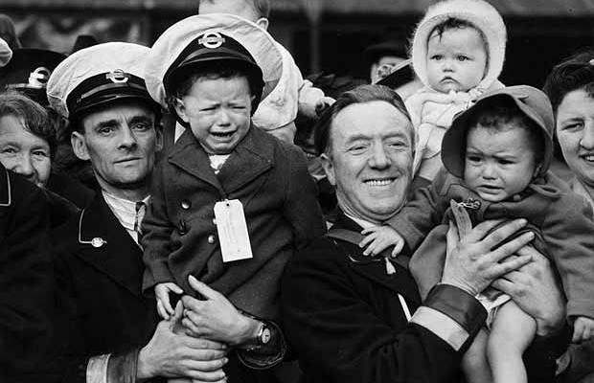
“The foster mother used to beat us with a leather belt which she kept on a nail by the fireplace. Afterwards my legs were bright red and stinging. I used to run to my bedroom where I hugged the collie dog.”
“I remember that the children in the village didn’t like us. Some children shouted ‘Go back to London, we don’t want you here.’ They held me down and put snails and frogs in my dress”

Slide 5
Meet the evacuees
You have each been given a role card and a clipboard with a grid on it. Your job is to talk to EVERYONE in the room to find out what their experience of evacuation was. After you have spoken to each person, make a judgement about how positive the view is +1 to +3, or negative (-1 to -3) and add any interesting notes. You will have to select a number of these memories to go on your website. The notes you make in the end column will help you to select them quickly.

Slide 6
Recording sheet
Person | +5 +3 | + +21 | +1 | 0 | -1 | -2 | -3 | Interesting comments you might use on website
1 Write name here
2
3
4
5
6
7
6

Slide 7
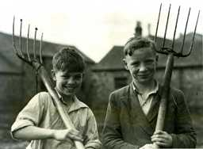
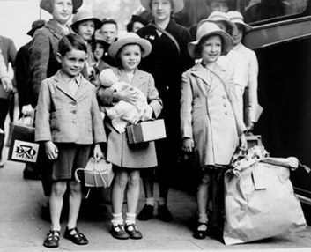
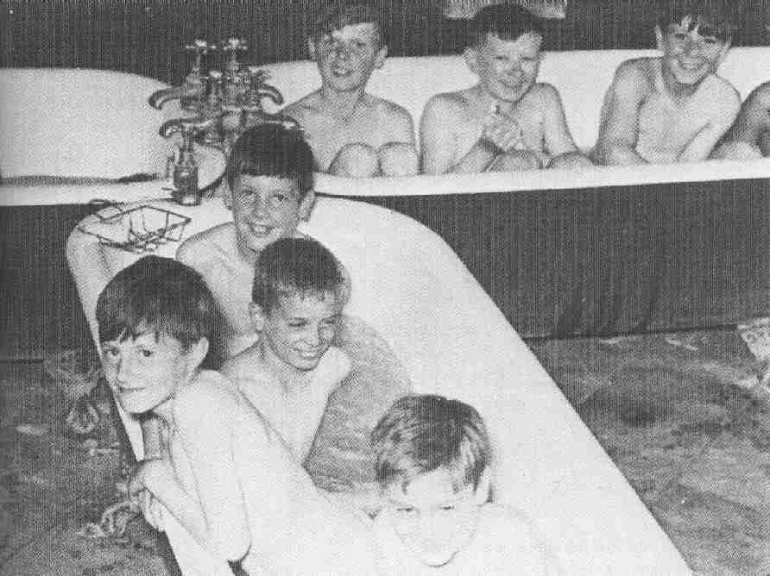
Photos of evacuees smiling, such as these, often appeared in newspapers. Can you think why?

Slide 8
A. The happy photos were all taken at the very start of evacuation, before they experienced what it was really like. | B. People tended to take photos of children when they were happy and not when they were sad.
C. The government printed photos of the evacuees looking happy to make sure that their mums didn’t worry and to make it seem as if evacuation was working. | D. There were lots of photos of unhappy children but they have all been lost over the last 60 years.

Slide 9
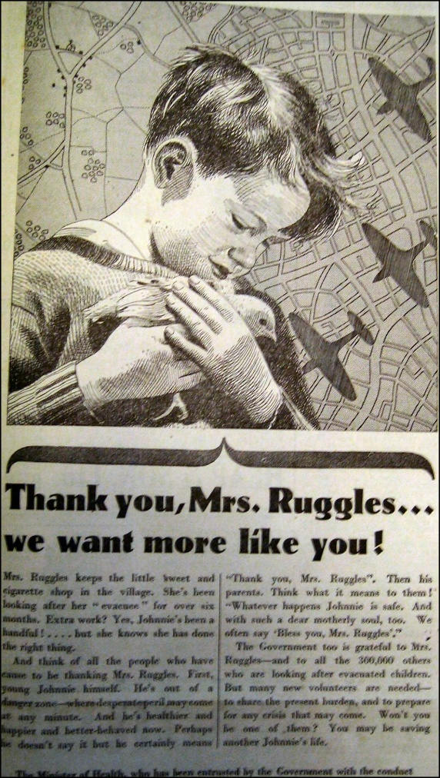
Can anyone work out why this picture was published?
Who do you think Mrs Ruggles was?

Slide 10
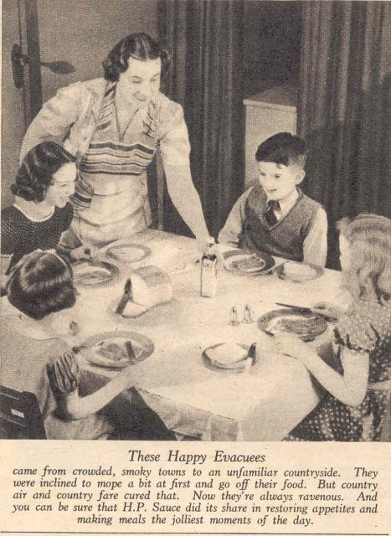
What about this one? Why does this show evacuees being happy?
Source: http://gallery.nen.gov.uk/assets/0906/0000/0191/ev015_the_happy_evacuees_mid.jpg

Slide 11
What about this one? Why does this show evacuees being happy?
http://gallery.nen.gov.uk/assets/0906/0000/0191/ev015_the_happy_evacuees_mid.jpg

