Slide 1
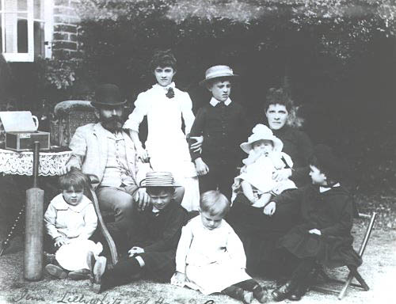
Using a Victorian census
Who is our mystery character?
The 1891 census comes to the rescue

Slide 2
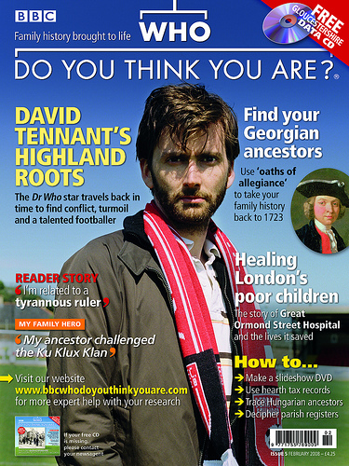
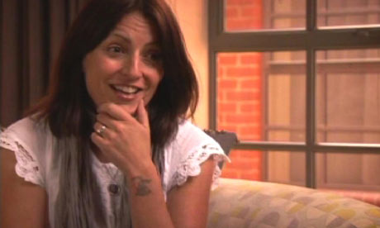
Several famous people today have tried to trace their ancestors using a CENSUS. They have gone back to Victorian times, over 100 year ago and even further back.

Slide 3
The next episode
The BBC is going to do a new programme about a famous family. One of the oldest surviving members of the family remembers 3 words about her ancestors, the one we are researching :
BOOK
SHOP
BAT
Our job is to find out who that person is and why they were famous. All we have is 3 words, a photograph...and , of course, a special document called a census.

Slide 4
On the back of the photograph is written ‘Me and the family 1887’
Any clues?

Slide 5


Look closer......
Also written on the front at the bottom, was the name Jim Lillywhite, Westhampnett Sussex, 1887

Slide 6
So now we can start searching
We have a special document called a census
It lists where everyone was living on a certain night of the year. It happened every 10 years.
They started drawing up the census in 1841
The nearest one in date to our photograph would be?......
1891
We could also use 1881 but why is that not so helpful?
The young children would not be born.

Slide 7
Shall we look at the census
It is for 1891 and the village of Westhampnett.
It is 120 years old.
The writing is awful!!
Can you find Jim Lillywhite’s name?
What job did he do?
Can you see his family listed below his name?

Slide 8
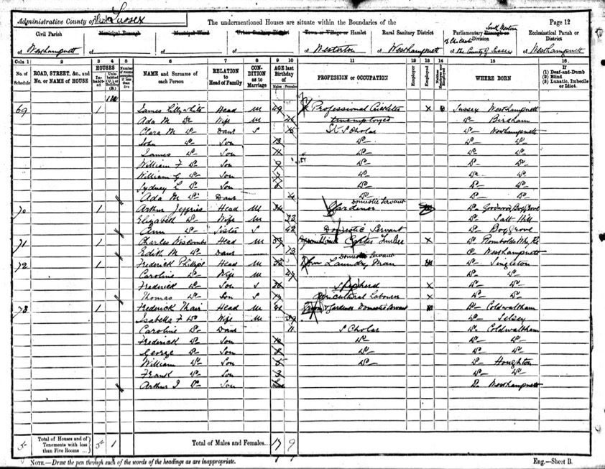
© National Archives

Slide 9
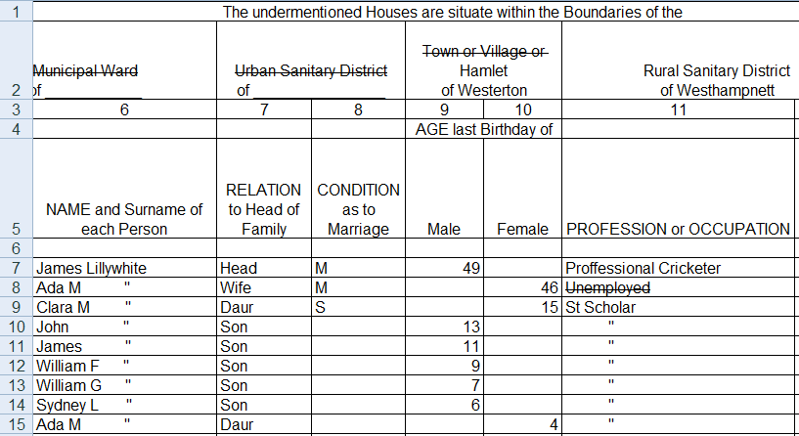
Fortunately we have a clear typed copy. You can see that even modern-day people make mistakes copying

Slide 10
Can we match the names to the people in the photograph?

Slide 11
Who is who in this photograph of the Lillywhite family?
Photo taken in 1887, 4 years before the census

Slide 12
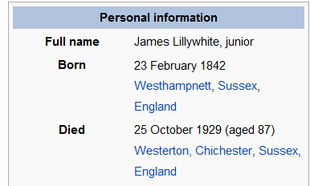
James Lillywhite

Slide 13
Now the rest of our puzzle
Book
Bat
Shop

Slide 14
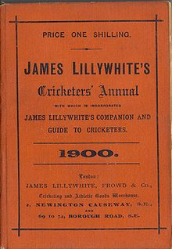
The book

Slide 15
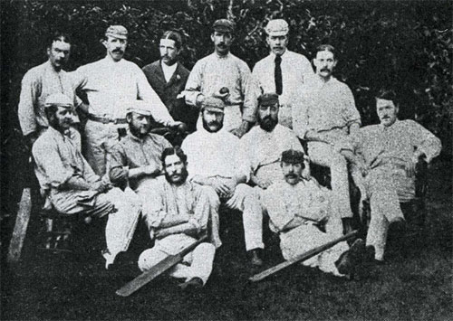
The bat?
This is a photo of the test team to Australia in 1877. Can you find James?
The bat?

Slide 16
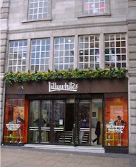
The shop
What do you think this London shop sells?

Slide 17
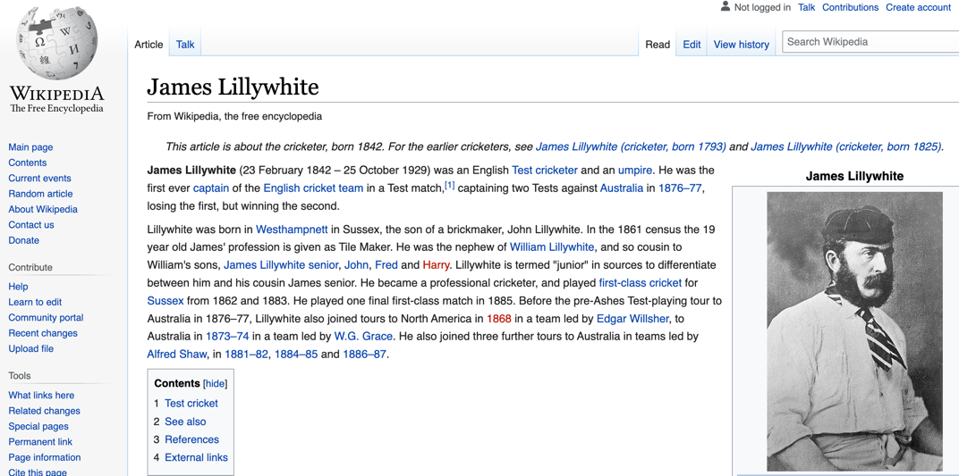
James Lillywhite

Slide 18
Credits
With thanks to the National Archives for permission to use selected samples of materials on their excellent website.

