Slide 1
The mystery of the empty grave

Slide 2
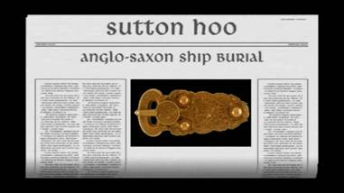
Sutton Hoo
Click here to show the start of the video to introduce the
Sutton Hoo site (first 45 seconds)

Slide 3


Slide 4
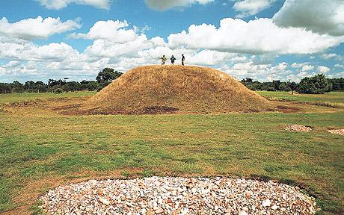

Slide 5
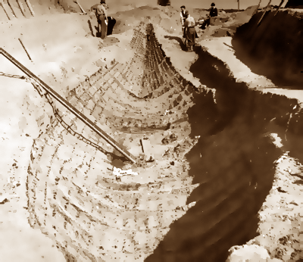

Slide 6
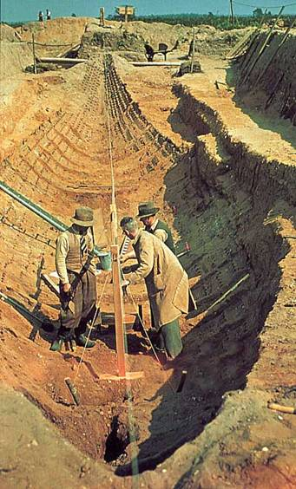
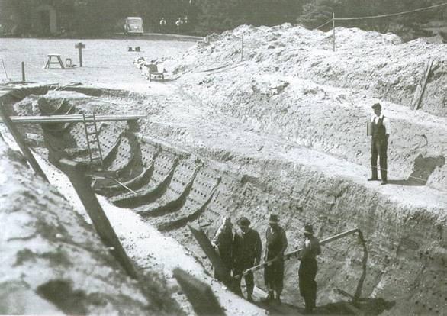

Slide 7
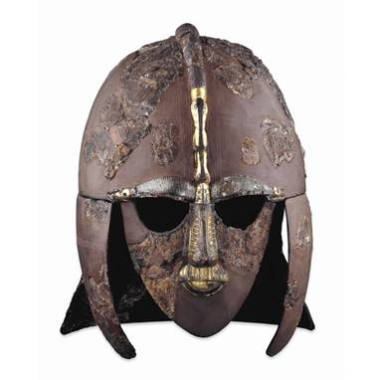
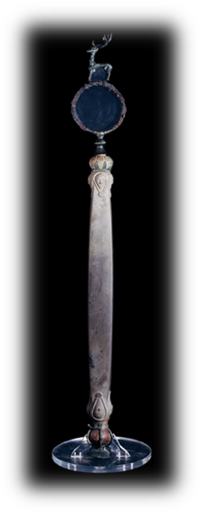

The finds

Slide 8
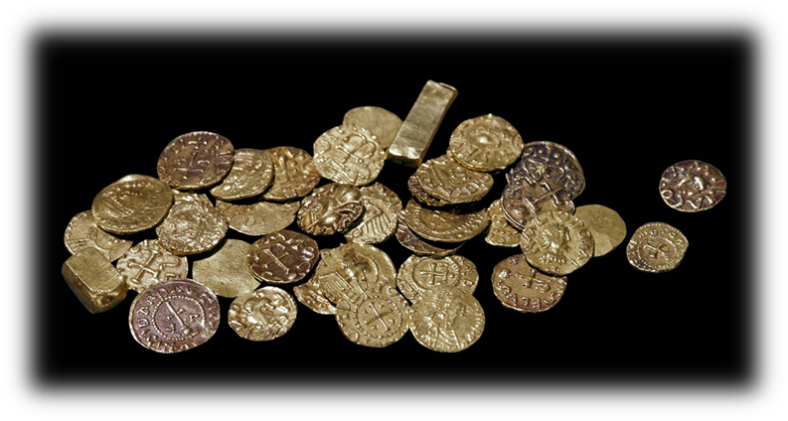
The finds
37 coins dated about AD 625

Slide 9
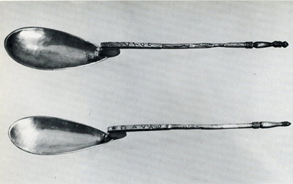
The finds
2 silver spoons
One spoon is inscribed Paul the other Saul
They are christening spoons
The owner at some time must have been Christian but the burial is pagan.

Slide 10
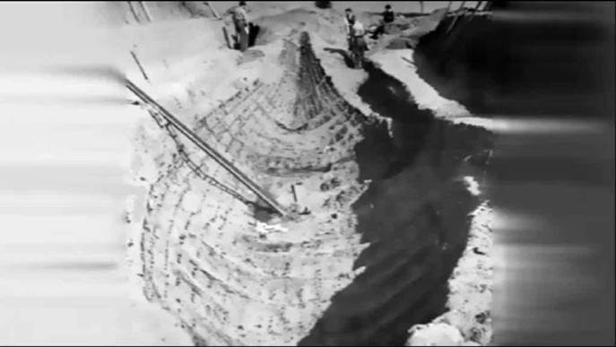
What do the finds tell us?
Watch the short video
Link is to beginning of clip: show from discovery of finds starting at 6min 15sec

Slide 11
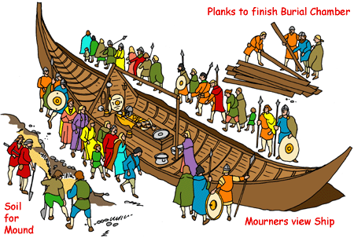
Artist's impression of the final scene

Slide 12
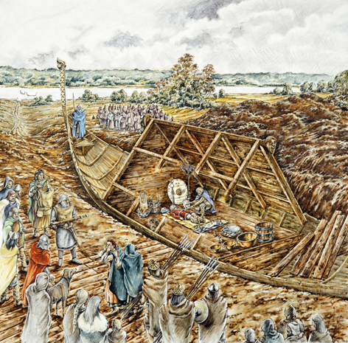
Source: http://www.bbc.co.uk/schools/primaryhistory/anglo_saxons/kings_and_laws/teachers_resources.shtml

Slide 13
Which clue tells us?
The owner must have been very important.
B. The owner was a king.
C. The burial must have been between AD 595 and AD 625.
D. The owner was an East Anglian.
E. The owner was possibly Christian at some stage.
F. The owner was a ‘superking’ or Bretwalda.

Slide 14
So who was he?
Here are 4 possible people it might be. Before we look at them let’s remind ourselves of what we are looking for?

Slide 15
Sigebert
A
He was the first English king to receive a Christian baptism.
Sigebert
Sigeberht of East Anglia (also known as Saint Sigebert) was King of East Anglia from c.629 to c.634.

Slide 16
Eorpwald
B
Eorpwald was the son of Raedwald and ruled as King of East Anglia from
c.624 to c.627.
Eorpwald
He received Christian teaching and was Christian in his ways.

Slide 17
Raedwald
Rædwald, was King of the East Angles from c. AD 600 until his death in c.624.
C
Raedwald
He was a Bretwalda, a superior king.

Slide 18
Offa
Offa of Mercia
He was a Bretwalda, a king who had power over other kings in England.
D
Offa
Many historians think Offa was the most powerful Anglo-Saxon king before Alfred the Great.
Offa was the King of Mercia from AD 757 until his death in July 796.

Slide 19
Why couldn’t it be Ethelbert?
Ethelberht, King of Kent (reigned c.560-616)
One of the most important Anglo-Saxon kings
who became the first English king to be converted to Christianity

Slide 20
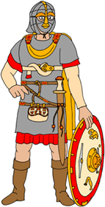
So, who is the owner?
Sigebert
Eorpwald
A
B
C
D
Raedwald
Offa

Slide 21
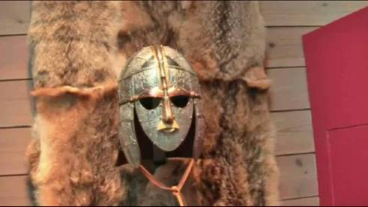
The answer?
Watch the last minute of this video clip to find out (forward clip
to start at 8.58)

Slide 22
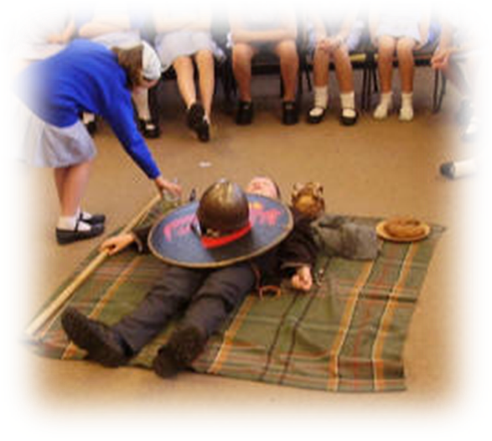
Draw onto this picture any objects that have been left out and then label each object, stating what it tells us about the owner.

Slide 23
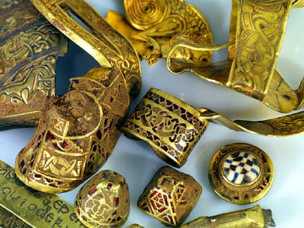
We carry on learning more about the Saxons each day. Recently this treasure hoard was discovered worth £3 million million.

